Slide 1
Statistical Description of Data
Univariate Summary Statistics

Slide 2
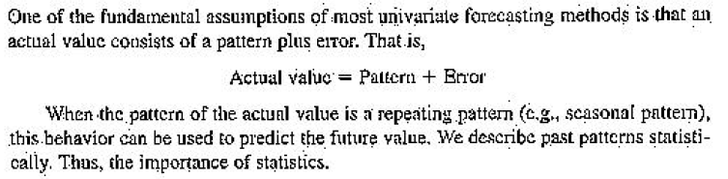
The importance of Patterns

Slide 3
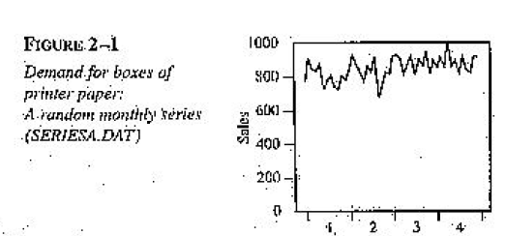
Forecasting
Average around 850. This can be forecast for the 49th month

Slide 4
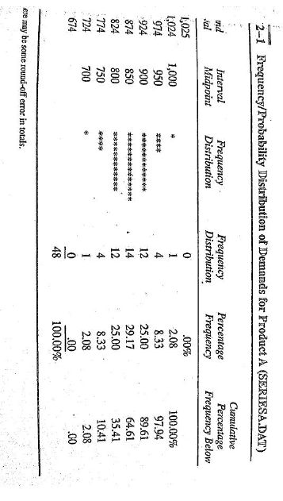
Graphical Representation

Slide 5
Probability Estimates using
Past Percentage Frequencies (rained 600d on 1000d = 0.6 probability of rain tomorrow)
Theoretical Percentage frequencies (e.g., tossing a coin => p=0.5)
Subjective Judgement (based on exp)

Slide 6
Univariate Summary Statistics

Slide 7
Shape – Center - Spread
When we gather data, we want to uncover the “information” in it. One easy way to do that is to think of: “Shape –Center- Spread”
Shape – What is the shape of the histogram?
Center – What is the mean or median?
Spread – What is the range or standard deviation?

Slide 8
Measures of Central Tendency,
Mean
µ, population; , sample
Weighted Mean
Median
Mode
The Center

Slide 9
Measures of Dispersion
Range
Variance
(Note the computational difference between σ² and s².)
Standard deviation
Interquartile range
The Spread

Slide 10
Measures of Relative Position
Quantiles
Quartiles
Percentiles

Slide 11
Measures of Association
Coefficient of correlation, r
Direction of the relationship: direct (r > 0) or inverse (r < 0)
Strength of the relationship:
When r is close to 1 or –1, the linear relationship between x and y is strong.
When r is close to 0, the linear relationship between x and y is weak.
When r = 0, there is no linear relationship between x and y.
Coefficient of determination, r²
The percent of total variation in y that is explained by variation in x.

Slide 12
The Center: Mean
Mean
Arithmetic average = (sum all values)/# of values
Population: µ = (Σx_{i})/N
Sample: = (Σx_{i})/n
Problem: Calculate the average number of truck shipments from the United States to five Canadian cities for the following data given in thousands of bags:
Montreal, 64.0; Ottawa, 15.0; Toronto, 285.0;
Vancouver, 228.0; Winnipeg, 45.0 (Ans: 127.4)
x

Slide 13
The Center: Weighted Mean
When what you have is grouped data, compute the mean using µ = (Σw_{i}x_{i})/Σw_{i}
Problem: Calculate the average profit from truck shipments, United States to Canada, for the following data given in thousands of bags and profits per thousand bags:
Montreal 64.0 Ottawa 15.0 Toronto 285.0
$15.00 $13.50 $15.50
Vancouver 228.0 Winnipeg 45.0
$12.00 $14.00
(Ans: $14.04 per thous. bags)

Slide 14
The Center: Median
To find the median:
1. Put the data in an array.
If the data set has an ODD number of numbers, the median is the middle value.
If the data set has an EVEN number of numbers, the median is the AVERAGE of the middle two values.
(Note that the median of an even set of data values is not necessarily a member of the set of values.)
The median is particularly useful if there are outliers in the data set, which otherwise tend to sway the value of an arithmetic mean.

Slide 15
The Center: Mode
The mode is the most frequent value.
While there is just one value for the mean and one value for the median, there may be more than one value for the mode of a data set.
The mode tends to be less frequently used than the mean or the median.

Slide 16
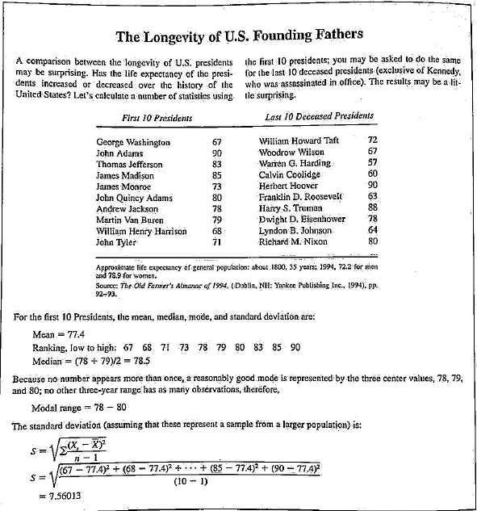

Slide 17
The Spread: Range
The range is the distance between the smallest and the largest data value in the set.
Range = largest value – smallest value
Sometimes range is reported as an interval, anchored between the smallest and largest data value, rather than the actual width of that interval.

Slide 18
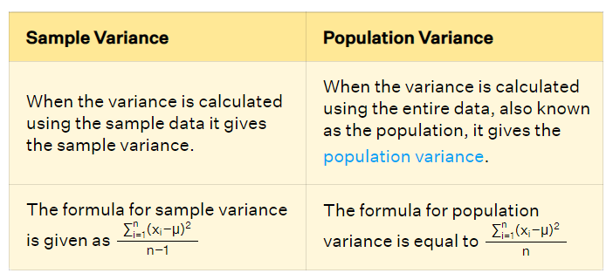
The Spread: Variance
Variance is one of the most frequently used measures of spread,
for population,
for sample,
The right side of each equation is often used as a computational shortcut.

Slide 19
The Spread: Standard Deviation
Since variance is given in squared units, we often find uses for the standard deviation, which is the square root of variance:
for a population,
for a sample,
.

Slide 20

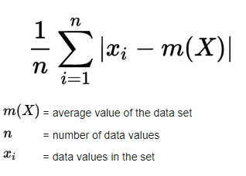
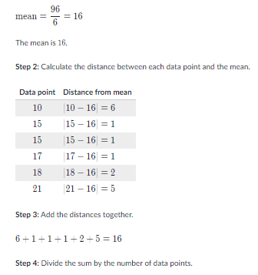
Mean Absolute Deviation(MAD)
MAD : 16/6 = 2.67

Slide 21
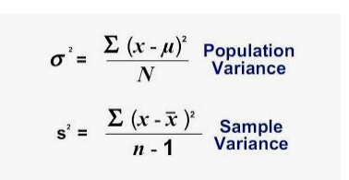
Variance

Slide 22
Shape: The “shape” of the data is called its “distribution”
If mean = median = mode, the shape of the distribution is symmetric.
If mode < median < mean, the shape of the distribution trails to the right, is positively skewed.
If mean < median < mode, the shape of the distribution trails to the left, is negatively skewed.
Distributions of various “shapes” have different properties
eg “normal” distribution, or “bell curve” (Gaussian Distribution).

Slide 23
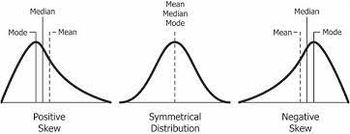
Skews

Slide 24
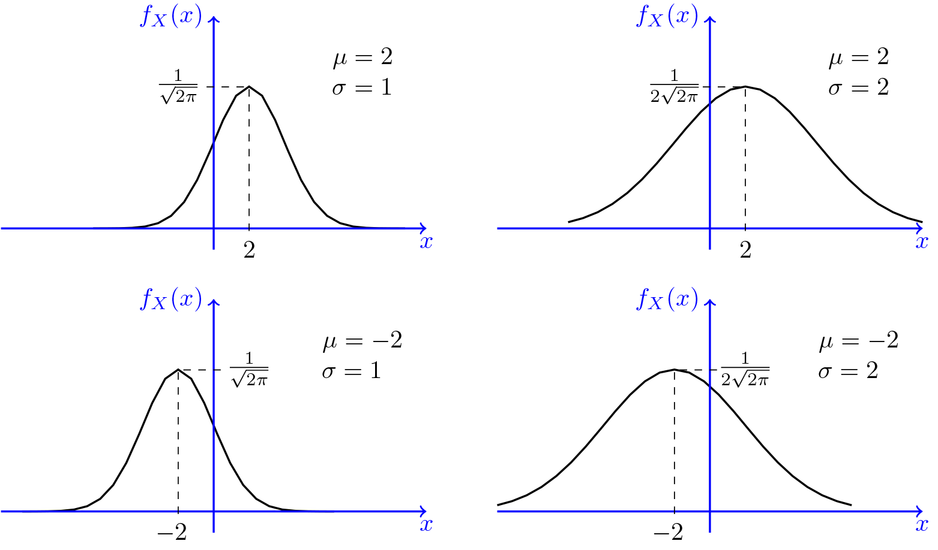

Slide 25
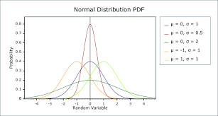

Slide 26
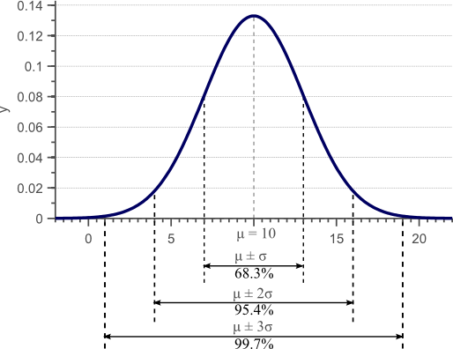

Slide 27
Summary -Exploring Univariate Data
Notes:
30

Slide 28
Measuring the Dispersion of Data
Measures to assess the dispersion or spread of numeric data:
range,
quantiles,
quartiles,
percentiles, and the
interquartile range.
Five-number summary, which can be displayed as a boxplot, is useful in identifying outliers.
Variance and standard deviation also indicate the spread of a data distribution.

Slide 29
Measuring the Dispersion of Data
Range:
Let X1,X2, : : : ,Xn be a set of observations for some numeric attribute, X.
The range of the set is the difference between the largest (max()) and smallest (min()) values.
Quantiles:
Assume data for attribute X are sorted in increasing numeric order.
Pick certain data points so as to split the data distribution into equal-size consecutive sets. These data points are called quantiles.
Quantiles are points taken at regular intervals of a data distribution, dividing it into essentially equal size consecutive sets.

Slide 30
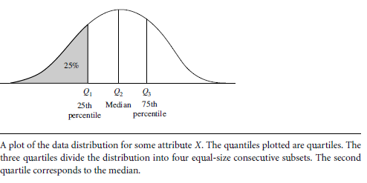
Measuring the Dispersion of Data--Quantiles
The 2-quantile is the data point dividing the lower and upper halves of the data distribution. It corresponds to the median.
The 4-quantiles are the three data points that split the data distribution into four equal parts; each part represents one-fourth of the data distribution. They are more commonly referred to as quartiles.
The 100-quantiles are more commonly referred to as percentiles; they divide the data distribution into 100 equal-sized consecutive sets.
The median, quartiles, and percentiles are the most widely used forms of quantiles.

Slide 31
Symmetric vs. Skewed Data
Examine Median, mean and mode of
symmetric,
positively skewed and
negatively skewed data
In a unimodal frequency curve with perfect symmetric data distribution, the mean, median, and mode are all at the same center value, as shown in Figure

Slide 32
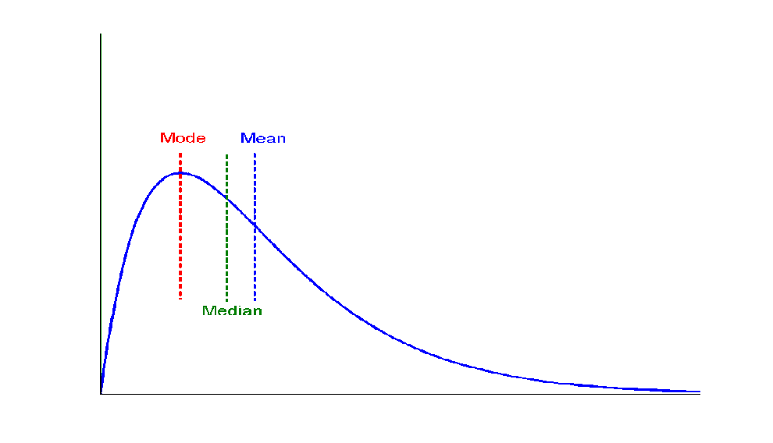
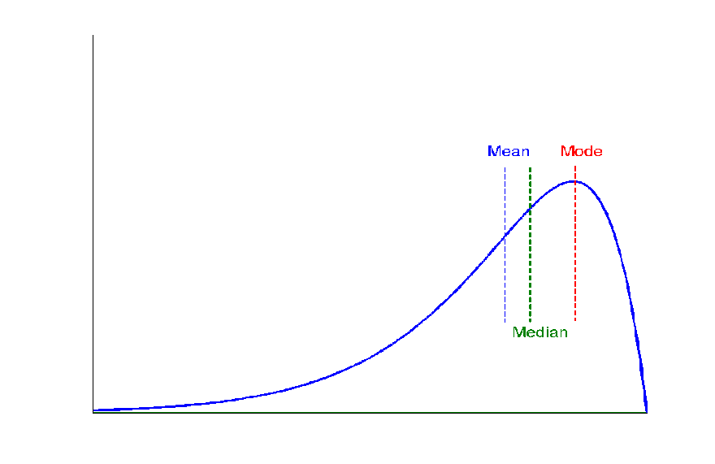
Symmetric vs. Skewed Data
Median, mean and mode of positively and negatively skewed data
Data in most real applications are not symmetric.
positively skewed: mode occurs at a value that is smaller than the median, or
negatively skewed: mode occurs at a value greater than the median (Figure).
+ve
-ve

Slide 33
Measuring the Dispersion of Data – Quartiles contd…
Quartiles: The quartiles give an indication of a distribution’s center, spread, and shape.
The first quartile(Q1), is the 25th percentile; cuts off the lowest 25% of the data.
The 3rd quartile(Q3), is the 75th percentile—it cuts off the lowest 75% (or highest 25%) of the data.
The 2nd quartile is the 50th percentile. As the median, it gives the center of the data distribution.
Inter Quartile range (IQR)
The distance between the 1st and 3rd quartiles is a simple measure of spread that gives the range covered by the middle half of the data.
Distance is called the Inter Quartile Range (IQR) and defined as IQR = Q3-Q1.

Slide 34
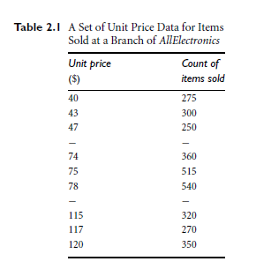
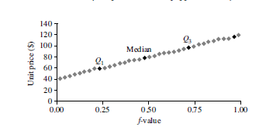

Measuring the Dispersion of Data - Quartiles
Income in Thousands of INR per month : 47,30, 36, 110, 50, 70 ,52, 60, 52, 56, 63, 70.
Find
Quartiles.
IQR
Median
Quantiles and Quantile Plots

Slide 35
Measuring the Dispersion of Data - Quartiles
In thousands: 30, 36, 47, 50, 52, 52, 56, 60, 63, 70, 70, 110.
Interquartile range.
The quartiles are the three values that split the sorted data set into four equal parts.
The data contains 12 observations(sorted in increasing order).
Thus, the quartiles for this data are the third, sixth, and ninth values, respectively, in the sorted list.
Therefore, Q1 is 47,000 and Q3 is 63,000.
Interquartile range ,IQR is 63000-47000 = 16,000.

Slide 36

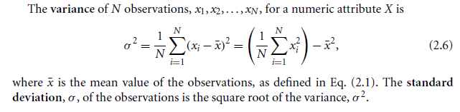
Variance and Standard Deviation
Variance and standard deviation are measures of data dispersion (indicate spread).
A low SD => that the data observations tend to be very close to the mean, while
A high SD indicates that the data are spread out over a large range of values.
SD Calculation:
Mean

Slide 37
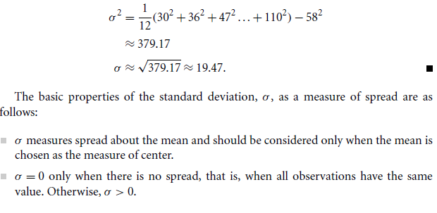
Variance and Standard Deviation

Slide 38
Relative Position - Quartiles
One of the most frequently used quantiles is the quartile.
Quartiles divide the values of a data set into four subsets of equal size, each comprising 25% of the observations.
To find the first, second, and third quartiles:
1. Arrange the N data values into an array.
2. First quartile, Q₁ = data value at position (N + 1)/4
3. Second quartile, Q₂ = data value at position 2(N + 1)/4
4. Third quartile, Q₃ = data value at position 3(N + 1)/4

Slide 39
Fitting Vs Forecasting
Fitting: use past data to fit model coeff
Forecast: use of a model to forecast unknown future values

Slide 40
Bias (Mean Error)
The Mean is used in forecasting as a measure of the typical error.
A good forecasting model should have a mean of zero because it should overcast and undercast approximately the same.
Because a good model is expected to have a mean zero error of zero, the mean error (ME) is a useful measure of systematic error, called Bias.

Slide 41
Occam’s razor –Principle of Economy (Law of Parsimony)
Occam’s razor is a principle of theory construction or evaluation according to which, other things equal, explanations that posit fewer entities, or fewer kinds of entities, are to be preferred to explanations that posit more.
It is sometimes misleadingly characterized as a general recommendation of simpler explanations over more complex ones.
The most useful statement of the principle for scientists is "when you have two competing theories that make exactly the same predictions, the simpler one is the better.

